Slide 1
Excel Final Assessment
Selva Viswanath Senthilkumar
4306 – LVADSUSR113
28 february,2024

Slide 2
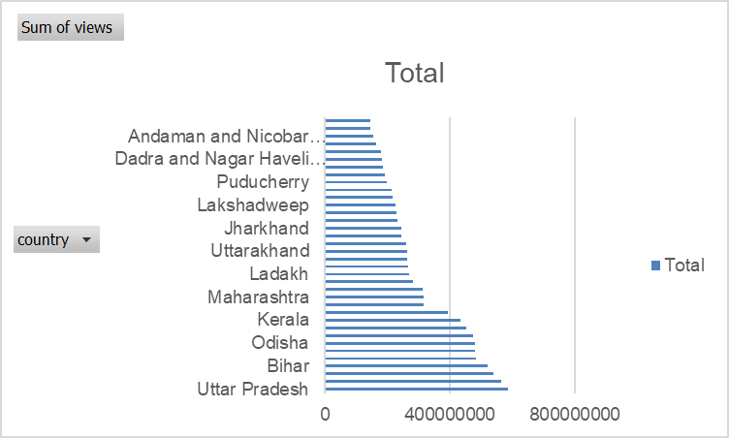
16: geographical analysis

Slide 3
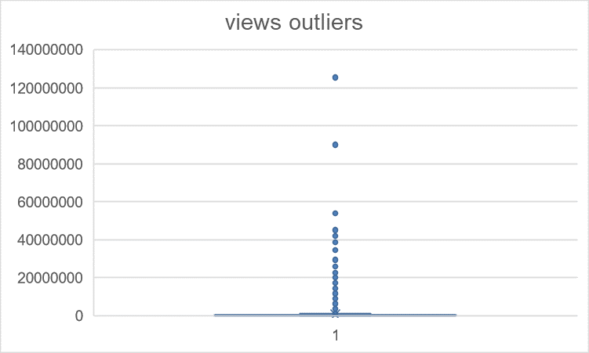
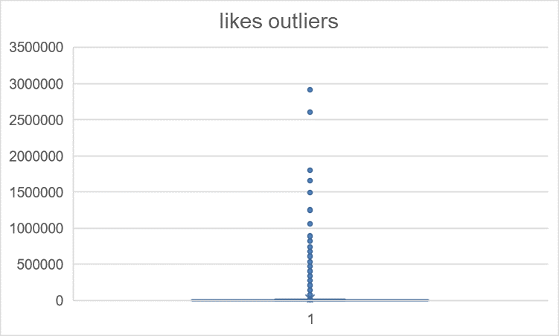
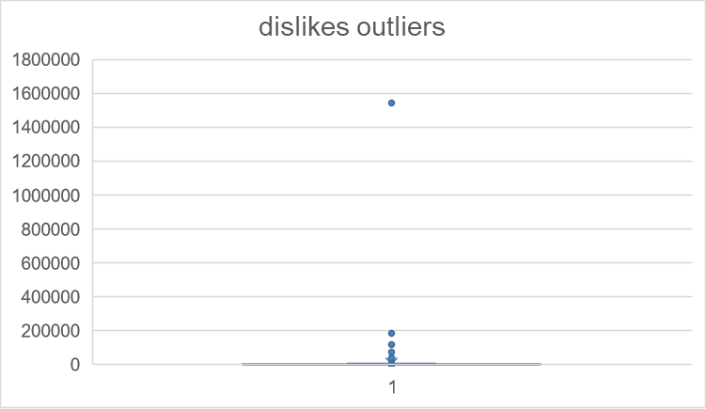
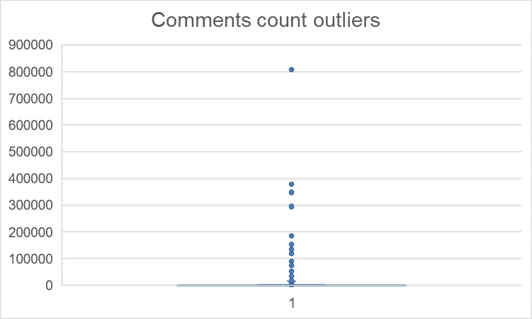
17:

Slide 4
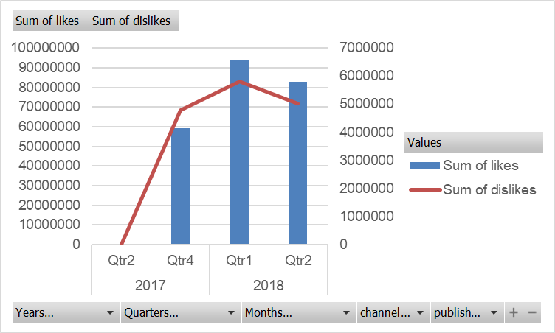
18:

Slide 5
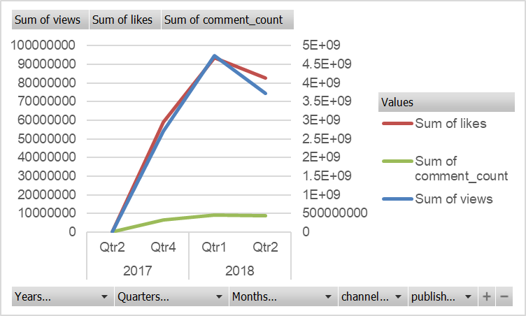
19:
Over period of year 2017 to 2018, there is huge growth

Slide 6
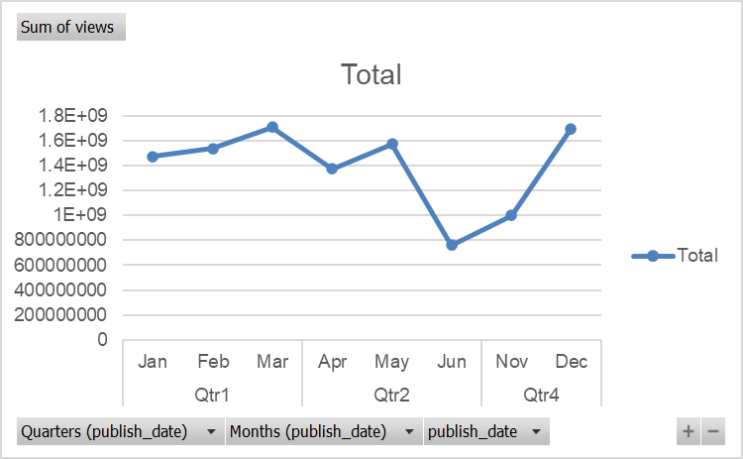
20:
The views has reduced highly in the month of June

